Slide 1
NCEA REVIEW update for I & O, 2020
Melanie Webber, Junior Vice President
Kirsty Farrant, PLD Co-ordinator
Adèle Scott, Advisory Officer Professional Issues
Notes:
Adèle:
What do you expect from this workshop?

Slide 2
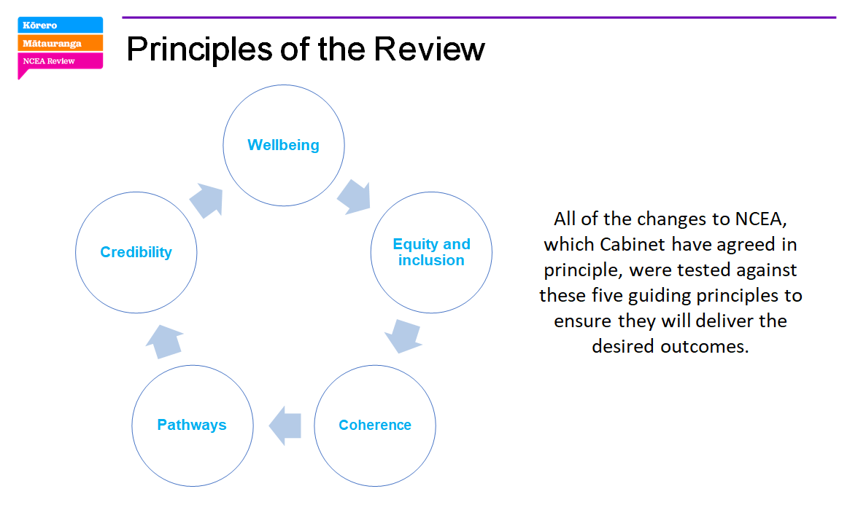
Background
Notes:
These are the principles of the review.
What are the big changes in the NCEA Change package…can you recall?
There are 7
NCEA Change Package
The Cabinet agreed in-principle with the changes and the Minister announced the NCEA Change
Package in May 2019. The seven changes are:
1. Make NCEA more accessible
2. Mana Ōrite mo te mātauranga Māori
3. Strengthen literacy and numeracy requirements
4. Have fewer, larger standards
5. Simplify NCEA’s structure
6. Show clearer pathways to further education and employment
7. Keep NCEA Level 1 as an optional level.

Slide 3

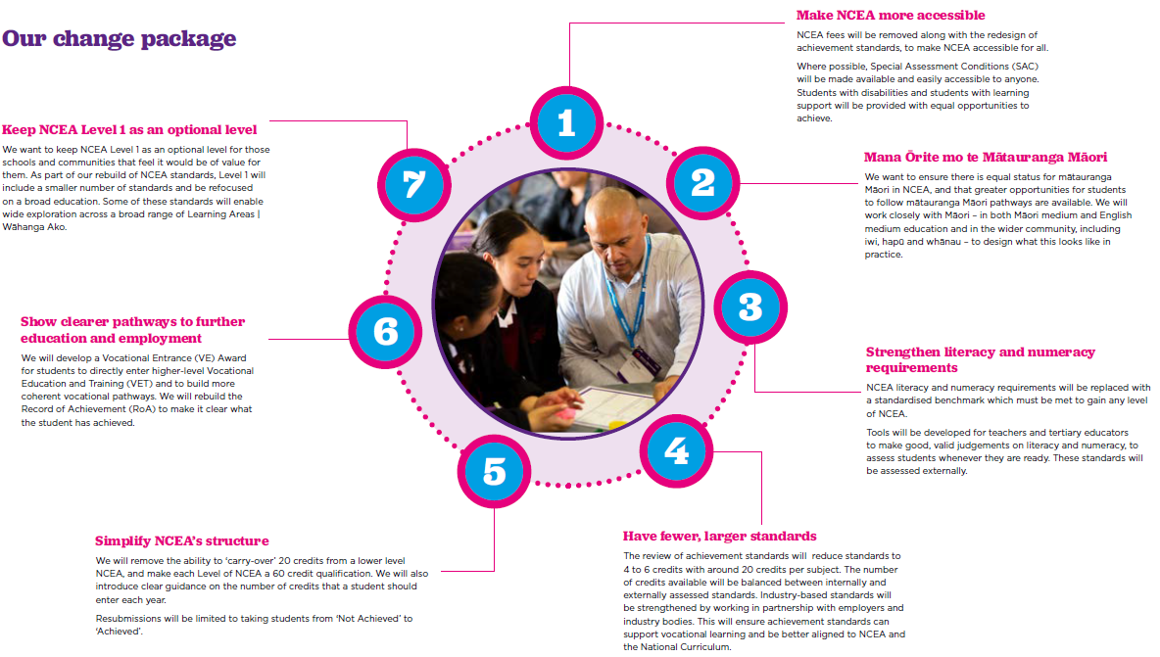
Notes:
Confirmed by cabinet February 2020.

Slide 4
Outline
Checking in –what are the changes?
Review of Achievement Standards (RAS)
Curriculum Progress and Achievement (CPA)
Teacher Only Days (TODs)
Notes:
Introduced 2002 – 2004
Each year 120,000 learners gain an NCEA
NZQF rules state that the NCEAs need to be reviewed every 5 years to check that each qualification “remains useful and relevant, and continues to meet the needs of the learners, industry and stakeholders for which it was initially developed”.

Slide 5
Review of Achievement Standards (RAS)
Most standards have not been systematically reviewed for five years or more. To be reviewed:
  All subject matrices
  All achievement standards
  All assessment resources, Teaching & Learning Guides and exemplars
Three assessment tasks and additional exemplars for each reviewed standard.
Subject Expert Groups have been running for Science, English, Religious Studies and Visual Arts – they have completed phase I
This is to test the processes
Notes:
We need to review all achievement standards derived from the National Curriculum – both the New Zealand Curriculum and Te Marautanga o Aotearoa.
Most standards have not been systematically reviewed for five years or more.
We will be reviewing:
- All subject matrices
- All achievement standards
- All assessment resources, TLGs and exemplars
We will be expanding supports to include three assessment tasks and additional exemplars for each reviewed standard.
This is an opportunity to action the outcomes of the NCEA Review that relate to achievement standards and resources.

Slide 6
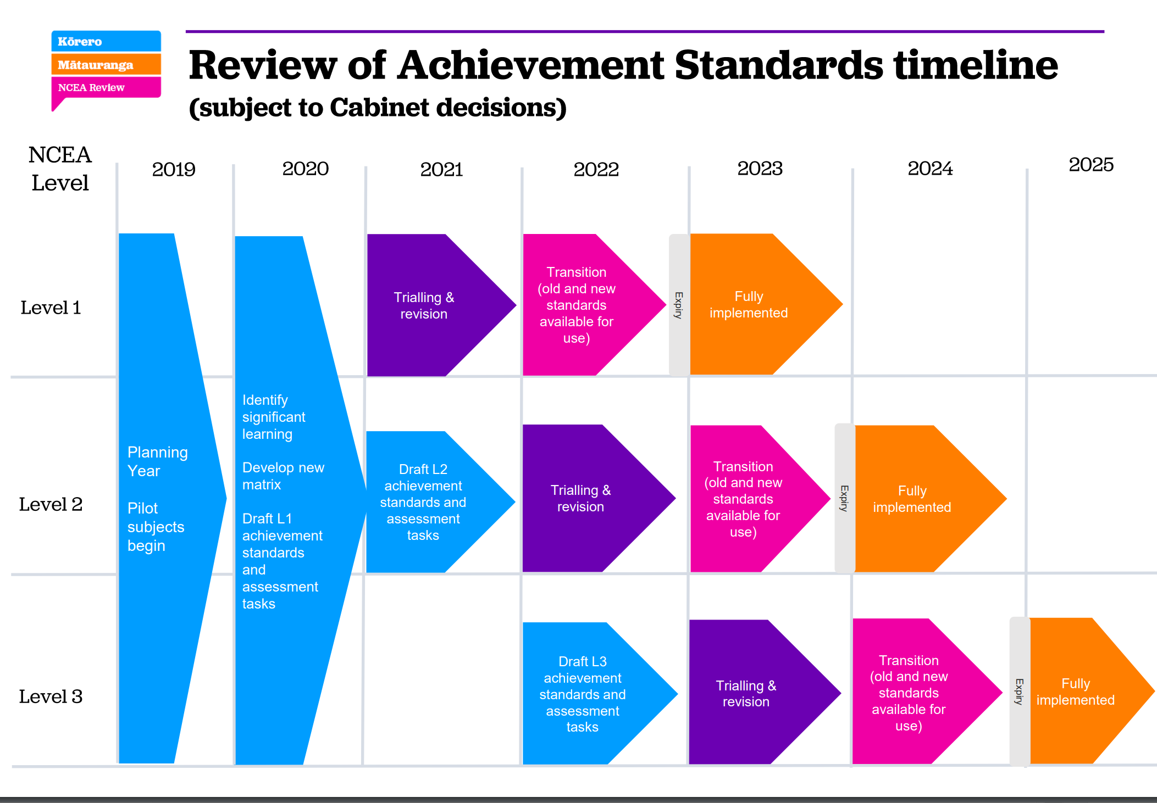

Slide 7
See separate pdf for
edited Ministry of Education’s update 4th March 2020
Note: Technology should be on the provisional list

Slide 8
TODs: Teacher Only Days
Eight Accord Teacher Only Days spread over the next three years:
2020 – 2 2021 – 3 2022 – 3
There is an Accord Sub-Group negotiating content, expectations, costs associated with travel
PPTA members will use the 8 days to attend the mandated secondary sector NCEA change days.
Dates for 2020 see next slide
Notes:
Eight additional Teacher Only Days were allocated in an Accord between the Ministry of Education, NZEI Te Riu Roa and PPTA Te Wehengarua. Information on these days for all settings is provided below.
All schools and kura will get eight additional teacher only days between now and 2022 once the Accord is ratified. These eight days will not extend the school year.

Slide 9
DAY 1 AUGUST
Date | Education Region 1 |  | Education Region 2
Tues 4th | Wellington |  | Otago Southland
Thurs 6th | Auckland |  | Canterbury
Mon 10th | Nelson/Marlborough/ West Coast |  | Bay of Plenty/Rotorua/Taupō
Wed 12th | Waikato |  | Hawke's Bay/Gisborne
Fri 14th | Tai Tokerau |  | Taranaki /Whanganui/Manawatū
DAY 2 NOVEMBER
Date | Education Region 1 | Education Region 2
Tue 17th | Wellington | Otago Southland
Thurs 19th | Auckland | Canterbury
Mon 23rd | Nelson /Marlborough/ West Coast | Bay of Plenty/Rotorua/Taupō
Wed 25th | Waikato | Hawke's Bay/Gisborne
Fri 27th | Tai Tokerau | Taranaki/Whanganui/Manawatū

Slide 10
What can I do?
Get involved in the discussions and feedback
Next one due APRIL 20 Submit comments about the provisional list
https://consultation.education.govt.nz/ncea/ras-provisional-subject-list/
The RAS work is being done by the Subject Expert Group members who are your colleagues, fellow PPTA members, subject association representatives

Slide 11
NCEA REVIEW
Your PPTA contact is
Adèle Scott, Advisory Officer Professional Issues
ascott@ppta.org.nz
04 913 4248
021 851 348

