Slide 1
Enhancing Wellness at Work
Doug Clark Advisory Officer
Notes:
To start this session I would like to just run through what it is and where we are at present

Slide 2
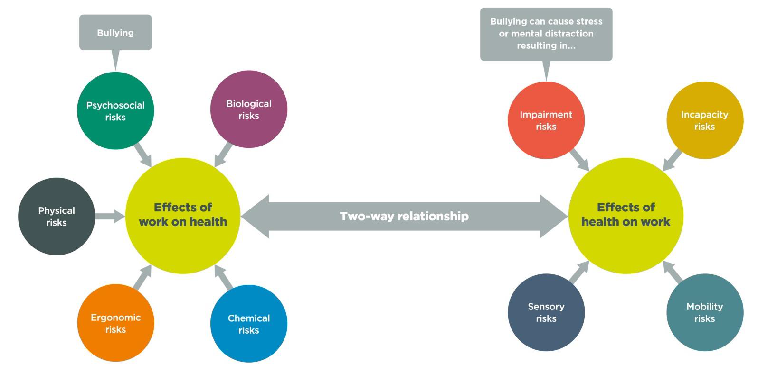
Work-related health risks and health-related safety risks It is well recognised that work can affect a person’s health, and a person’s health can affect safety at work.
Notes:
Self evident that health affects work and work affects health

Slide 3
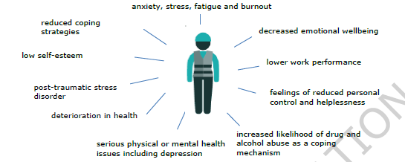
Bullying can be a significant source of harm for workers. Bullying can affect people both mentally and physically. The risks that result from bullying have a moderate to high likelihood of occurring, and moderate to high adverse consequences
Notes:
Bullying is a major source of harm

Slide 4
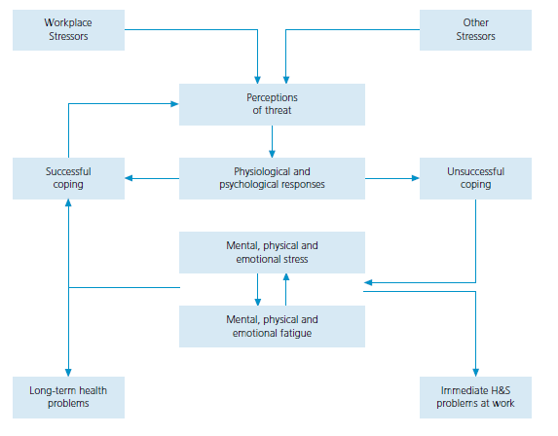
Academic model of stress interactions
Notes:
Illustrating the effects of unmitigated stress

Slide 5
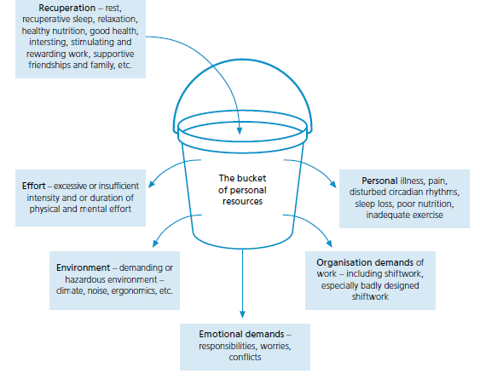
The bucket model of stress and fatigue
m
Notes:
And the bucket model where nobody else can tell you that your bucket is full or empty
only you can do this

Slide 6
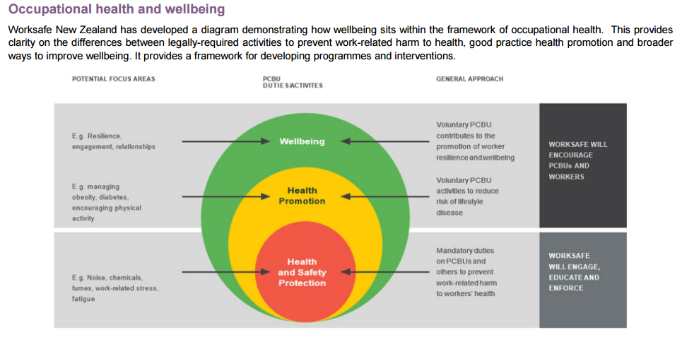
Notes:
So where is well being in all of this? While H & S is now enforceable Health promotion and wellness are only to be encouraged

Slide 7
Notes:
While we may lead in some areas we still have a long way to go

Slide 8
Notes:
So what is this thing called wellbeing??

Slide 9
And why does work matter
Notes:
And why does work matter?

Slide 10
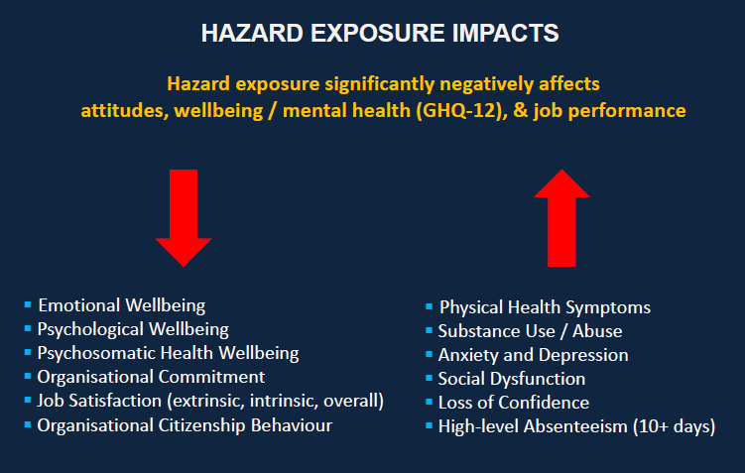
Notes:
As the left hand side decreases the right hand side increases and vice versa

Slide 11
Notes:
And as you can see harden up the 3 fs etc don’t necessarily work

Slide 12
Notes:
In order to investigate wellbeing, it is necessary to understand two conceptually different elements that determine wellbeing. These elements are the hedonic and eudemonic aspects of wellbeing
Hedonic corresponds psychologically to a state of pleasure or feeling good, through a release of chemicals in the brain. This can occur through basic sensory pleasures received through food and physical arousal, or through social pleasures.
Eudemonic corresponds to a cognitive perception of morally living well, in which the individual feels their life is valuable, meaningful and engaging.

Slide 13
Notes:
And obvious to most

Slide 14
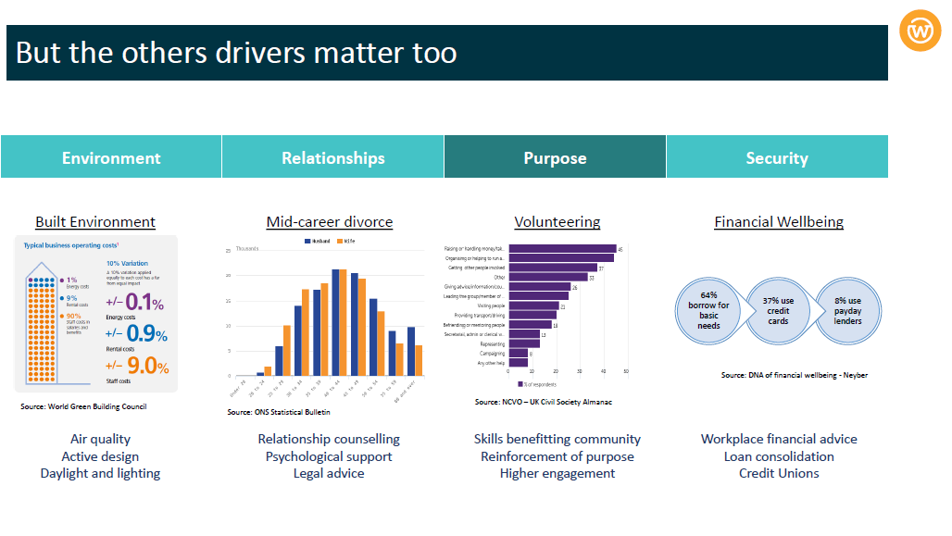

Slide 15
Notes:
One of my favourite quotes

Slide 18
Notes:
Worksafe are promoting a systems approach

Slide 20
Notes:
So how are we going to do this??

Slide 21
Whakapapa and future direction Vision: We want a workforce that is well supported, connected and motivated to bring out the best for the tamariki mokopuna of Aotearoa. Kei te hiahia matou ki tetahi kaimahi e tino tautokohia ana, e hono atu ana, e hihiri ana ki te whakaputa i nga mea pai mo nga mokopuna o Aotearoa
Notes:
Our vision

Slide 22
A commitment to wellbeing for education professionals 2017 International Summit on the Teaching Profession (ISTP) commitment made by the N Z delegation to “better support teacher wellbeing”. Ministry of Education asked to work with the sector to identify “what more could be done to enhance quality teaching, and support teacher and principal wellbeing”.
Notes:
At the 2017 International Summit on the Teaching Profession (ISTP) a commitment was made by the New Zealand delegation of government and union representatives to “better support teacher wellbeing”.
As part of this commitment Minister of Education Hekia Parata asked the Ministry of Education to work with the sector to identify “what more could be done to enhance quality teaching, and support teacher and principal wellbeing”.

Slide 23
As part of the Workforce Strategy, Union leaders and Ministry officials have been working in partnership to advance the concept of teacher and principal wellbeing. This is our strategic approach.
Notes:
Since the 2017 Summit, government and union representatives have reported back on progress towards their wellbeing commitment, reaffirmed their commitment to wellbeing for education workers at the 2018 Portugal ISTP, and Education Minister Chris Hipkins has announced his 2018 Education Portfolio Work Programme, which included the development of a future-focused Education Workforce Strategy.

Slide 24
Theme 1: Shared Understandings T h i s t h e m e i s a b ou t c r e a t i n g c o h e r e n t a n d c o n s i s t e n t m e s s a g e s a b o u t we l l b e i n g f o r o u r e d u c a t i o n w o rkf o r c e .
Notes:
A lack of clear, shared understandings of wellbeing in the sector has resulted in inequitable, ad hoc and incoherent policies and practices which can be seen to have a negative effect on education worker productivity and retention.

Slide 25
What we will do Outcomes
Develop a wellbeing framework
Develop an implementation plan
Facilitate engagement with all stakeholders
All stakeholders have a shared understanding of wellbeing for education professionals
Notes:
The ‘wellbeing’ of the education workforce interacts reciprocally with all parts of their professional practice and is affected by the different contexts they work in, their day to day experiences, their conditioned responses and their access to support. It can also be impacted by things far beyond the day to day work context (e.g. community poverty, availability of mental health services and learning support).

Slide 26
Our Approach The development of an Education Professionals’ Wellbeing Framework has been a collaborative process, with government agencies and leaders of the education sector working together. The framework is built on our shared responsibility to ensure all those who work within the education sector are supported, connected, empowered and well.
The ‘Tiered Supports’ that sit alongside the Framework demonstrate our shared focus on providing supports that will make a real difference to the wellbeing of those who work in our education system.
The framework and tiered supports will intersect with the development of an Education Workforce Strategy for Aotearoa.

Slide 27
A 3 tiered approach to implementation
Tier One
Outlines the levers that exist to ensure universal provision of wellbeing supports for the education workforce
Tier Three
Details the procedures and resources for responding to an individual’s and/or group’s crises.
Tier Two
Describes a more structured programme of care, support and resources to aid the development of board, principal, teacher and support staff capability.
Notes:
The three tiers outline the universal provision workers in education should expect to be able to access at their places of employment, through to targeted supports for those who need them.
The development of Tier One Guidance is currently in progress through the Accord, the EWSG, the Review of ITE, the NCEA Review and the Compliance Reduction Working Group.

Slide 28
The development of Tier One Guidance is currently in progress through the Accord, the EWSG, the Review of ITE, the NCEA Review and the Compliance Reduction Working Group.

Slide 29
Tier Two and Three Guidance
The actions in the Tier Two and Three Guidance have been left reasonably broad – to reflect the environment of Tomorrow’s Schools (where Boards are autonomous and so as not to overburden principals with a large set of compliance tasks).
Nevertheless, they outline some principles that should guide how education workers can access support when things are starting to go wrong.

Slide 30
Tier Two Pastoral care, Support and Training
A continuation of Tier 1 activities with a more structured programme of care and support. The programme includes regular activities and resource allocation necessary for these activities to happen and can include specific activities to build capacity
Notes:
NB a reminder The development of Tier One Guidance is currently in progress through the Accord, the EWSG, the Review of ITE, the NCEA Review and the Compliance Reduction Working Group.
Priority actions 1 assist development of sense of autonomy and purpose about work. Working should make people feel good.
2 BoTs (employers) support staff actively and constructively
3 Develop a proces for regular checks on mental health and wellbeing
4 Develop an active process to resolve issues and deal with negative social interactions
5 Develop managers and staff awareness of, and ability to recognise, the signs of poor mental health
6 Develop a culture of responsiveness that supports constructive discussion when staff are finding things hard. Offer a chance to talk about mental health and expalin the help and support they can get (EAP etc)

Slide 31
Tier Three Responding to Crisis, Monitoring and Evaluation
The development of appropriate tools, processes and practices
that are fully resourced to allow full implementation
Notes:
1 have appropriate referral process to primary care support and EAP available to all
2 have funding and support mechanisms I place that retain confidentiality of staff needing support
3 BoTs have process in place for senior staff (SLT) separate from other staff
4 There is a clear pathway for managing negative social interactions racism, bullying etc
5 the national safe schools framework embraced by this framework is applied to staff as well as students
6 traumatic incidents are supported with appropriately trained staff

Slide 32
Developing an implementation plan for the Wellbeing framework
The implementation plan will:
Identify the tools and resources that are currently in place
Identify what’s not in place and may/will need to be developed.
Consider the development of measures for success.
4. Be subject to endorsement by the wider EWSG.
Notes:
The approach will:
1. Be co-designed.
2. Be based on good change management principles.
3. Include other stakeholders when necessary.
4. Be focused on maximising engagement with and use of the Framework.

Slide 33
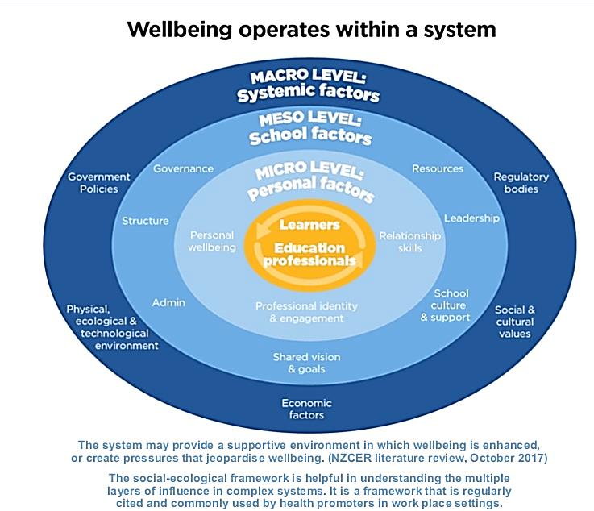
An Education Professionals’ Wellbeing Framework
Notes:
To maximise the utility of the Framework and demonstrate the importance of its socio-ecological underpinnings it is proposed that the identification, curation and development of resources, tools and supports that already exist (as well as where there are gaps) should be mapped to the ‘macro’, ‘meso’ and ‘micro’ layers.

Slide 34
Macro Level How the system supports Wellbeing Meso Level Wellbeing as a collective responsibility Micro Level Being well as individuals in the system
Notes:
This theme is about:
• Acknowledging how Macro-level policies and decisions have a bearing on the wellbeing of the workforce.
• Developing and coordinating supports for the workforce to ensure their wellbeing.
What we will do
Identify what tools and supports are already in place
Consider the impact of:
The Review of Tomorrow’s Schools,
The compliance reduction working group,
The development of an Education Workforce Strategy,
Funding Subject Associations and Supporting Networks of Expertise
Identify what else needs to be done:
e.g Review and improve the Wellbeing at Schools Survey for use by Teachers and Principals, implement change management protocols across Sector,
Develop templates/guidance for Wellbeing Policies in Schools etc
Create an online portal for wellbeing support/research
Meso
This theme is about:
• Acknowledging how middle-level policies and decisions have a bearing on the wellbeing of the workforce.
• Providing a nexus point for changes within education to ensure exemplar employment practice, particularly with
regards collaboration, change management and equitable support for all workers.
• Ensuring that the operation of policies and procedures at every school or learning centre support wellbeing.
What we will do
Identify what tools and supports are already in place
Consider the impact of:
The review of Tomorrow’s Schools,
The review of the Restraint Guidelines
The funding of the Wellbeing @ Schools Survey
Identify what else needs to be done:
e.g. Develop policy and guidance for schools
Identify and curate wellbeing resources for use by schools
Socialise PPTA’s Change Management Toolkit, Require ERO/EEO (or other) to monitor operation of Wellbeing policies in schools etc,
Micro
This theme is about:
• Acknowledging how micro-level practices and behaviours have a significant impact on wellbeing.
• Promoting concepts and practices based on best evidence that encourage individual workers to have agency over their own wellbeing.
• Responding to the needs of individual workers.
What we will do
Identify what tools and supports are already in place
Consider the impact of:
The NCEA Review
Funding Subject Associations and Supporting Networks of Expertise
Funding TRCC Wellbeing Courses
Identify what else needs to be done:
e.g. Provide an all schools contract for EAP services
Socialise tier 2 and 3 guidance to schools

Slide 35
Regional Health & Safety and Wellbeing Courses From 2020 PPTA, the Ministry of Education and Worksafe will provide regionalised seminars on Health and Safety and wellbeing.
Notes:
You have all had the flyers in your conference bag but here it is again just in case. Note that the courses are free but you will need to get PD leave to cover relief costs travel etc unless you are an elected HSR

Slide 37
Theme 2: Shared Supports
This theme is about ensuring equitable access to wellbeing support for our education workforce
Notes:
Wellbeing supports should be systematic, available to all education stakeholders across all settings and be understood and valued by policy makers, employers and workers.
Consequently, it is acknowledged that all stakeholders (including the Ministry, employers, unions and agencies) should be jointly responsible and accountable for the development, promotion and sustainability of wellbeing supports for education workers.

Slide 38
What we will do Outcomes
Co-develop tier 1 Wellbeing support for all kura
Create an online resource hub
Review and socialise existing programmes
Promote the use of tier 2 supports and guidance for all kura
All stakeholders have guaranteed access to wellbeing support, tools and resources
Notes:
System levers
Within the framework the mechanisms that might help to promote wellbeing for education workers are described as ‘levers’.
While there will be on-going work to develop the system level ‘levers’ for each of the wellbeing domains, some can already be broadly outlined.
These include:
⇒ Quality initial teacher education.
⇒ Continuing professional development.
⇒ Quality induction and mentoring.
⇒ Guidance to support school policies for healthy work environments.
⇒ Leadership programmes for principals and senior leaders that specifically assist them to enhance connectedness in their school.
⇒ Guidance on building supportive school culture.
⇒ Processes for monitoring and improving school systems that support wellbeing.
⇒ Fit for purpose principal and teacher wellbeing policies and regulations.
⇒ Processes for monitoring and reporting on wellbeing measures in schools.

Slide 39
Through the tripartite accord between unions and government there will be an on-going focus on how these levers can be deployed to improve education worker wellbeing.
Notes:
This could involve:
⇒ Including explicit reference to education worker wellbeing within the guiding legislation for schools and kura.
⇒ Requiring policy development in education to include analysis of the impact on the wellbeing of education workers.
⇒ More coherence across resourcing and support decisions for education (e.g. PLD, ITE, Learning Support).
⇒ Better understanding of wellbeing demonstrated through improvements to employment agreements

Slide 40
Theme 3: Shared Practices
What we will do Outcomes
Develop a draft Wellbeing
policy for use in kura All education settings
employ practices that
Develop evidence based promote Wellbeing for
adaptable guidance for workers
stakeholders
Provide opportunities for
school leaders to co-develop
Wellbeing support and
guidance
Notes:
This theme is about ensuring all schools, kura and early learning service can promote staff wellbeing through their policies, procedures and culture.
While acknowledging the autonomy of each learning service, best practice resources and guidance for worker wellbeing should be available for all in the system.
Accordingly, removing some of the burden for school leaders and employers to identify, source and access wellbeing supports should, in turn, enable their focus to be on promoting coherent and evidence based approaches that support worker wellbeing and productivity.

Slide 41
Wellbeing for education professionals - a strategic pathway
2019
Launch Framework
Co-Develop Tier One Wellbeing supports through Accord Process
2020
Launch Wellbeing Resource Hub
Inaugural Wellbeing Conference and Regional Follow ups
2021
Policy changes
EWSG implementation
Collective Bargaining preparation
Notes:
So in summary

Slide 42
Any Questions ??? Contact Doug Clark hands@ppta.org.nz

